Slide 1
Web Service Testing API REST
Antonio Robres Turón

Slide 2

Agenda
Introduction API REST
Analysing API REST
Intercepting API REST
Postman
Python Introduction
Python Data Types
Python Advanced
Request library
Framework with nosetest

Slide 3
Introduction

Slide 4
What is REST
Representational State Transfer
REST are a way to represent resources and manipulate it.
REST is a communication between client and server
REST gives developers a simple and flexible interface to write web services and communicate web pages with servers.

Slide 5
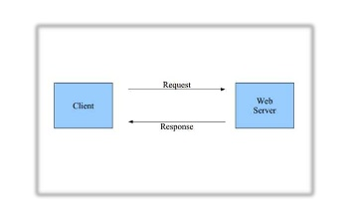
What is REST
REST is based on HTTP protocol

Slide 6
What is REST
Client requests a specific resource to server
Server sends a response with the resource requested.
All the requests are independent from the others (stateless)

Slide 7
REST request parts
URI → Uniform Resource Identifier
Method / Action
Headers
Body
Query parameters
Cookies
Files

Slide 8
API REST Example
REST Request
GET http://forum.com/security?news=yes
Accept: text/html
GET is the method or action
http://forum.com/security?news=yes is the URI or resource
Accept: text/html are the headers

Slide 9
API REST Example
REST RESPONSE
HTTP/1.1 200 OK
Content-Type: text/html
body:
{news: [Android: security breach discovered,
Global: NSA cracks iPhone X]}

Slide 10
URI
Is the resource ID
All the resources should be accessible using an URL
The URIs should be unique
Example
http://library.com/restapi/books/elquijote
http://mail.com/api/user/twiindan/correos
http://mail.com/api/user/twiindan/correos?new=yes

Slide 11
Methods
GET → Fetches a resource (cacheable)
PUT → Change a resource
POST → Creates or change a resource
DELETE → Deletes a resource
HEAD → Get the resource metainformation
OPTIONS → Get all allowed methods that may be used on this resource

Slide 12
Response Codes
2XX → Successful Codes
200 OK
201 Created
3XX → Redirection Codes
301 Moved permanently
Not modified
4XX → Client Error Codes
400 → Bad request
403 → Forbiden
404 → Not found
5XX → Server Error Codes
500 → Internal Server Error
504 → Service Unvailable

Slide 13
REST request analisys

Slide 14
Client / Server Communication Analisys
There are several applications (almost all free) to analyse REST requests between client and server.
Google Development Tools
Firefox Development Tools
Fiddle
Charles proxy

Slide 15
Google Development Tools
Google development tools have a feature to analyse the HTTP requests and responses done over Chrome.
Is possible analyse all the requests done by the browser when you are interacting with a webpage (images, js, css, REST requests…)

Slide 16
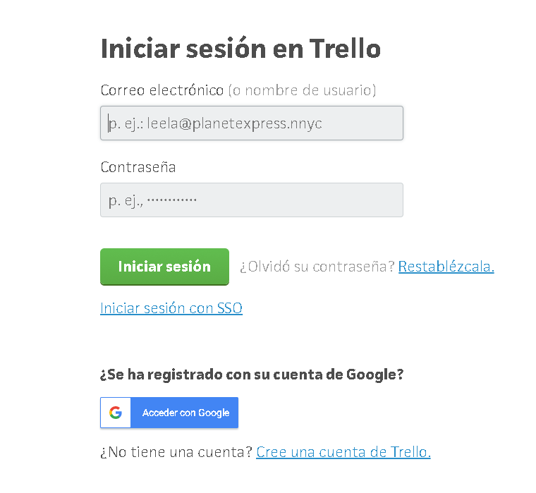
Example

Slide 17
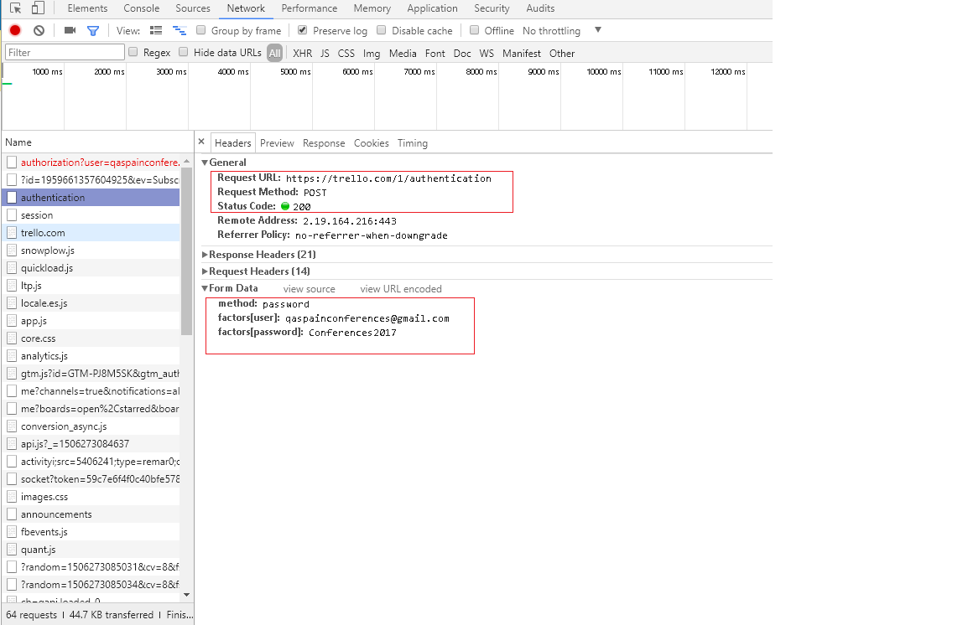
Example

Slide 18
Fiddler
Fiddler is a HTTP proxy. The HTTP traffic pass through the proxy to analyse it
Is compatible with all the navigators and terminals (also mobiles)
The proxy should be accessible in the network
IMPORTAT: If we want analyse also the HTTPs traffic (secure HTTP) we should install a SSL certificate.

Slide 19
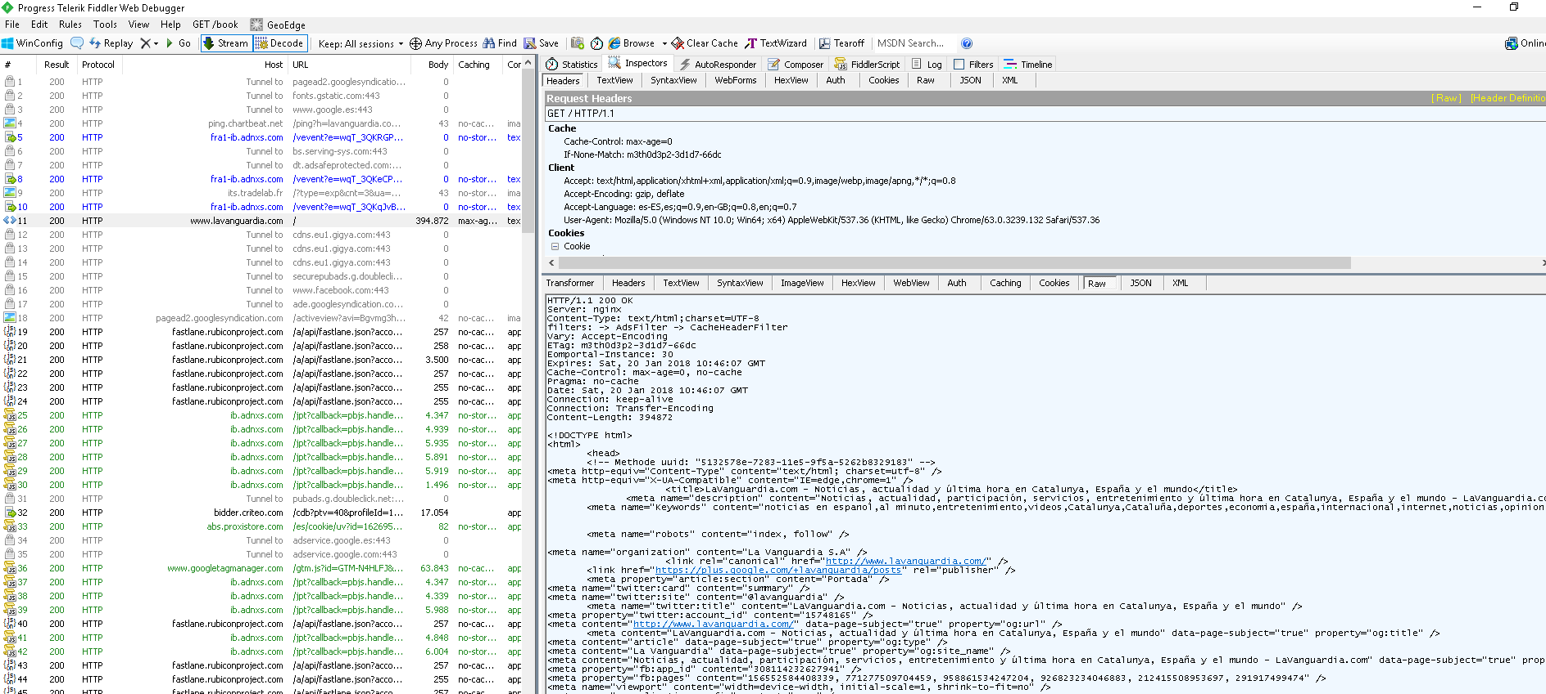
Fiddler example

Slide 20
REST interception
Burp Suite

Slide 21
HTTP traffic interception
There are tools that allow intercept all requests and responses and manipulate it before is sent to the client or server
Burp Suite
Traffic interceptor (proxy)
Traffic retention and manipulation
Allows intercept and manipulate all the requests and responses parameters (URI, methods, headers, body…)

Slide 22
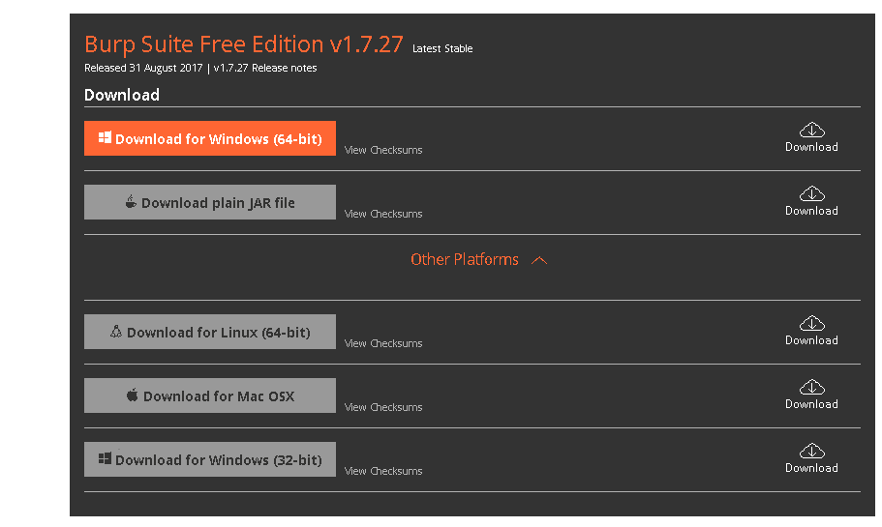
BurpSuite
Download from https://portswigger.net/burp
Available for Windows, MacOS and Linux

Slide 23
Configuration
To intercept the HTTP traffic is required configurate the BurpSuite application and the browser
BurpSuite
Proxy → Options → Proxy Listeners
Firefox
Options → advance settings→ network → Configuration

Slide 24
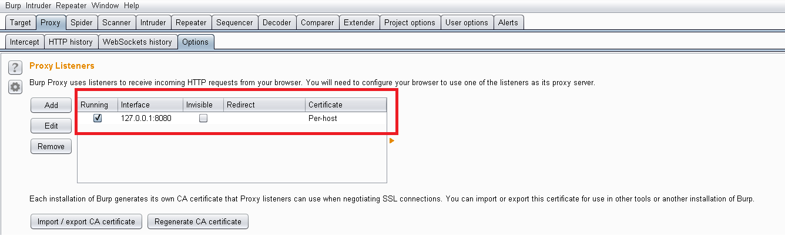
Burpsuite configuration

Slide 25
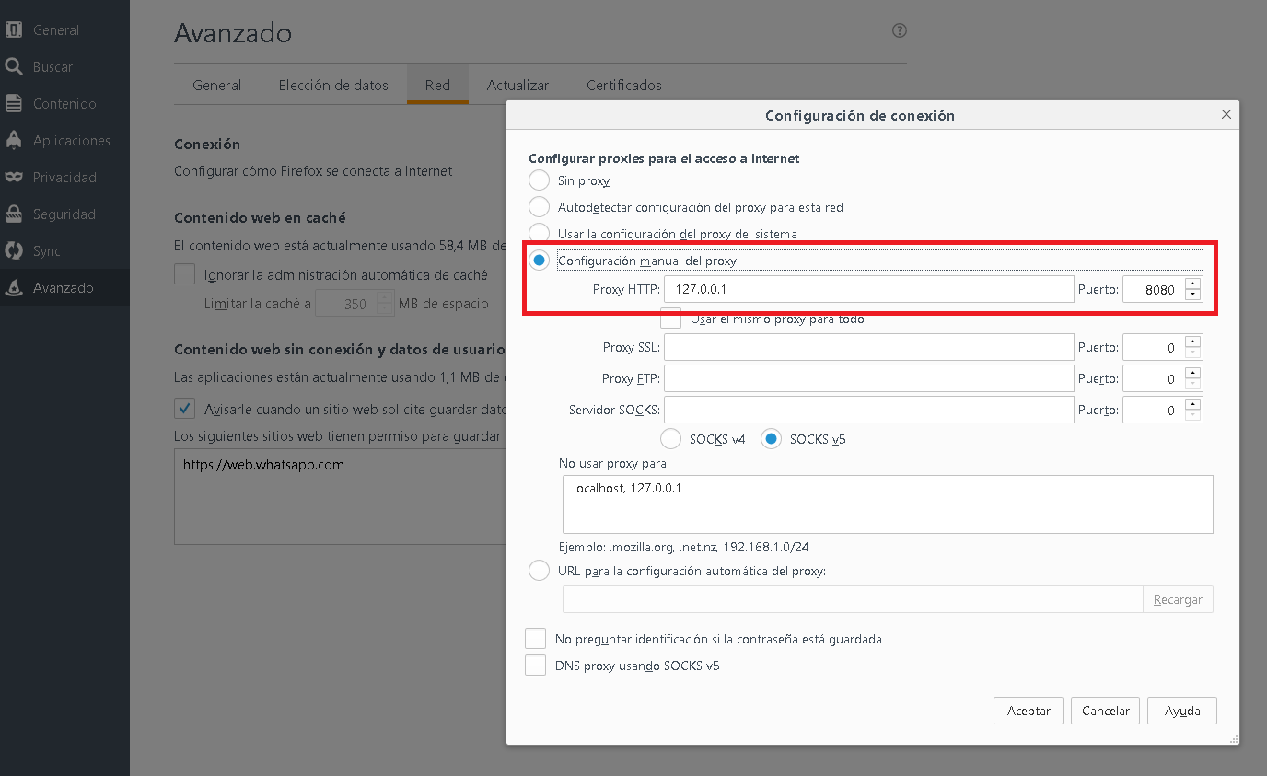
Firefox Configuration

Slide 26
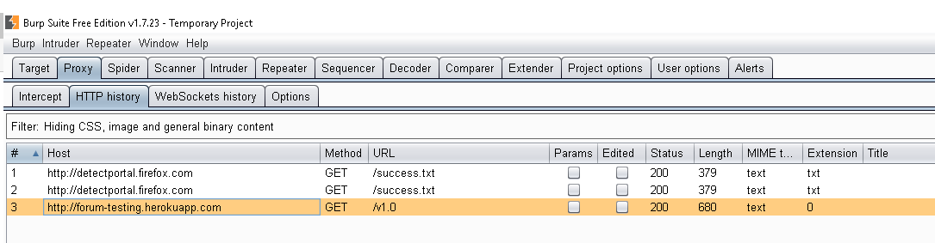
HTTP history

Slide 27
SSL interception
Go to http://burp/
Download certificate
From Firefox
Options → Privacy and Security → Certificates → View certificates → Authorities → Import
Select the downloaded certificate
Trust in this CA to identify Web sites

Slide 28
Repeat requests
Is possible repeat the requests existant in the HTTP history
Right click over the request
Send to repeater
GO to repeater
Click on GO button

Slide 29
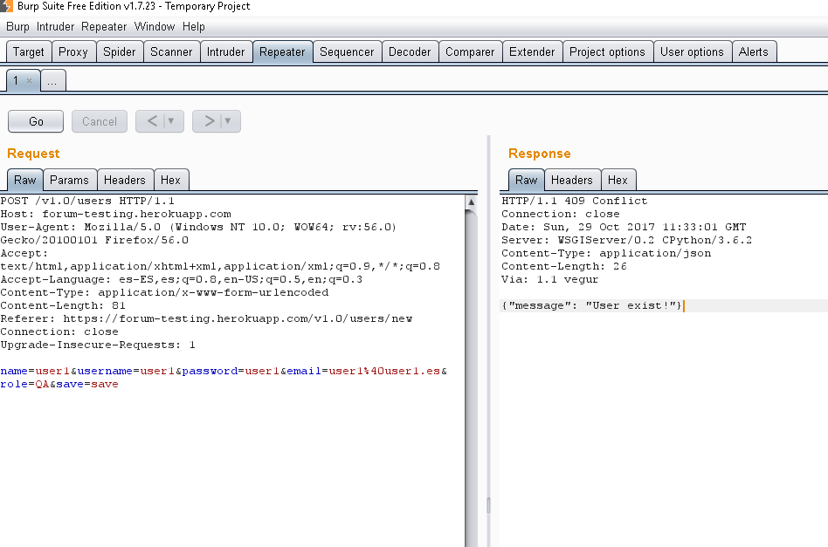
Repeat requests

Slide 30
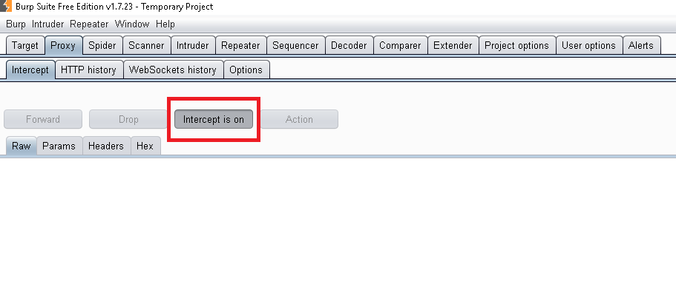
Request interception

Slide 31
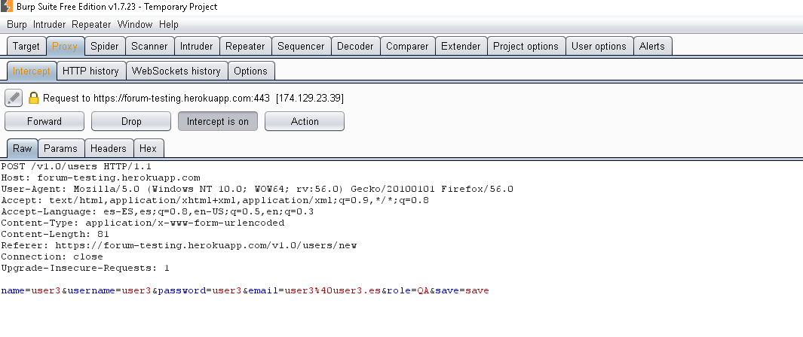
Interception example

Slide 32
Interception example
When the request was intercepted we can change all the parameters of the requests
URL
Query parameters
Body
Cookies
etc

Slide 33
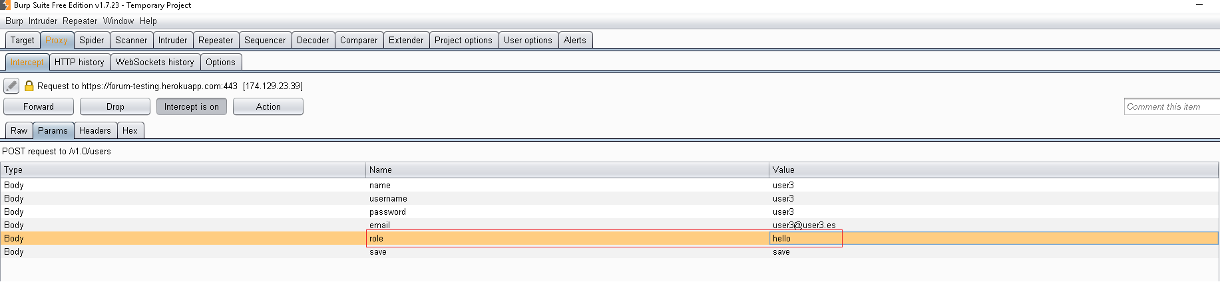
Interception example

Slide 34

FoxyProxy
Application to change the browser proxy settings
There are addons for Chrome and Firefox

Slide 35
FoxyProxy Configuration
Add new proxy
Details tab
IP → Burp IP (127.0.0.1)
Port→ Burp Port (8080)
General tab
Proxy name
To activate it right click in the FoxyProxy icon and select the proxy created

Slide 36
Remember
Shutdown the interceptor if we only want analyses the traffic
Shutdown the proxy when we are not testing
Advice:
Intercept only the request we want to manipulate using filters

Slide 37
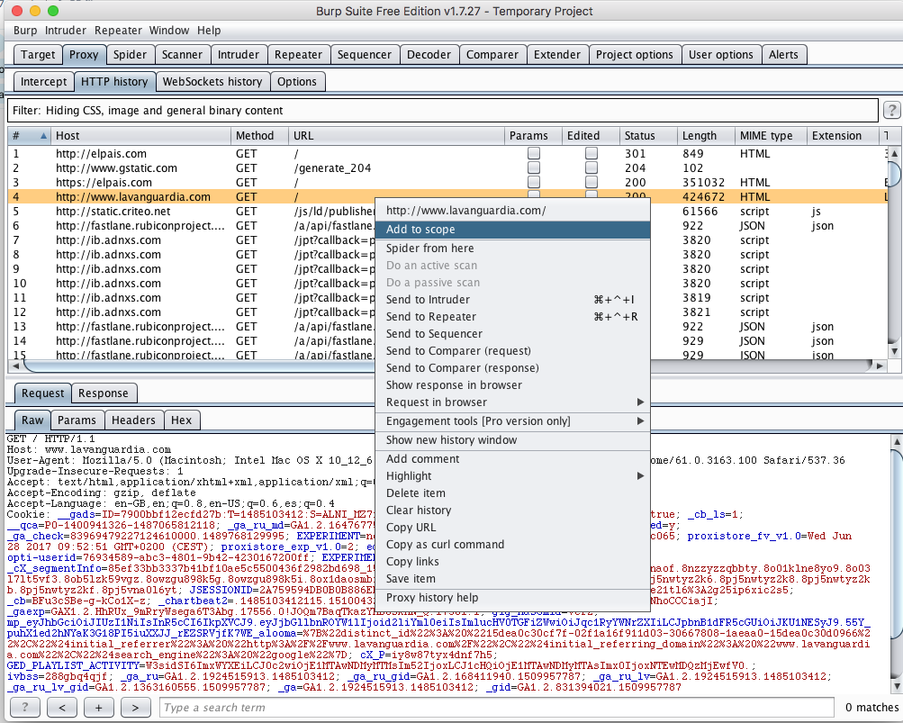
Burp Suite filters

Slide 38
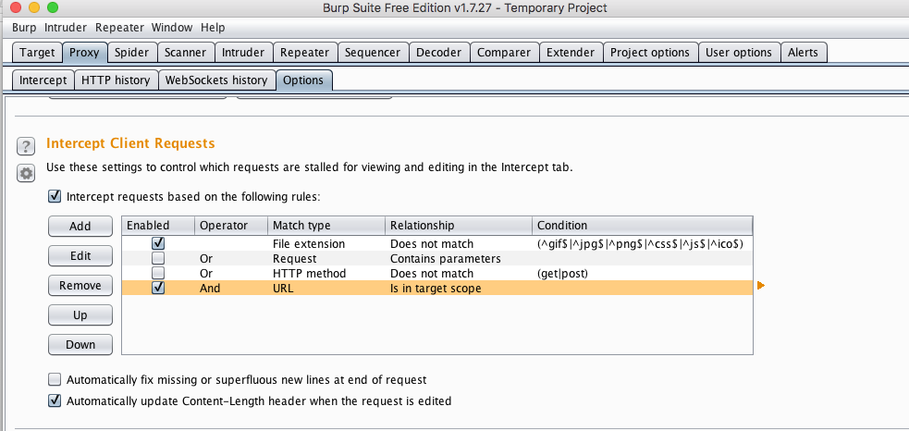
Burp Suite Filter (Request)

Slide 39
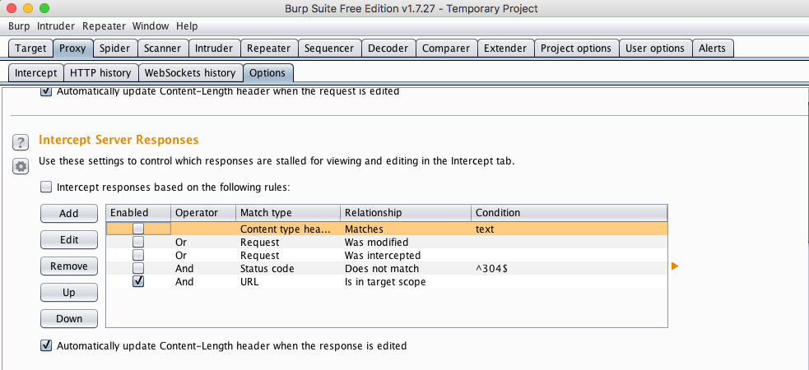
Burp Suite filters (Response)

Slide 40
Send REST requests

Slide 41
Postman
Download URL: https://www.getpostman.com/
Available for Windows, MacOS y Linux
Available Add-on for Chrome

Slide 42

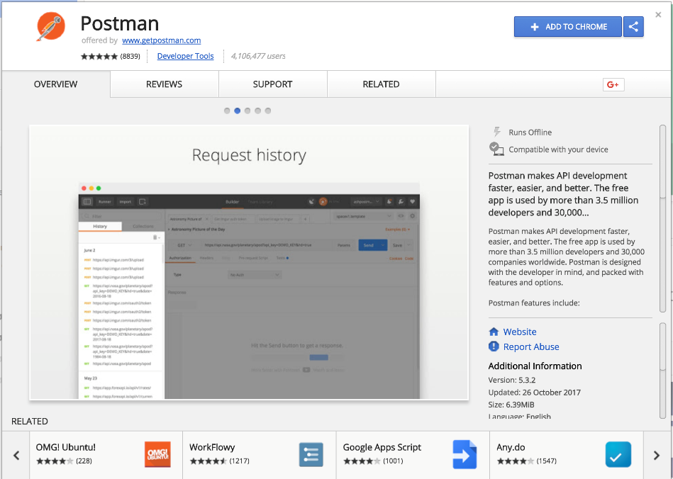
Download postman: https://getpostman.com

Slide 43
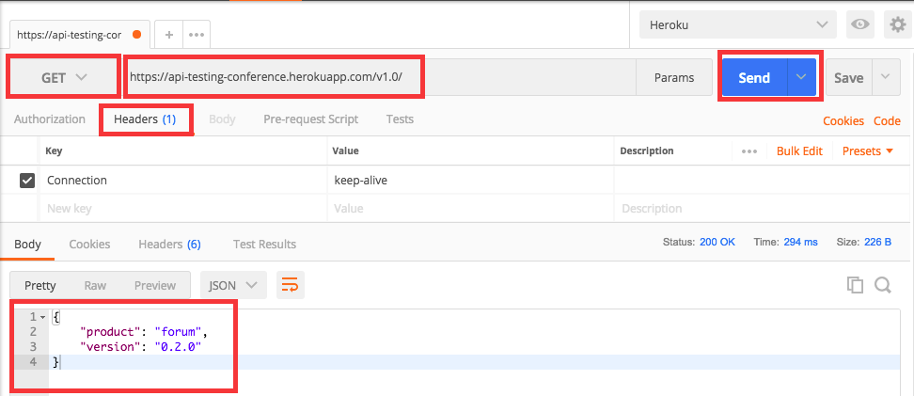
Create a request

Slide 44
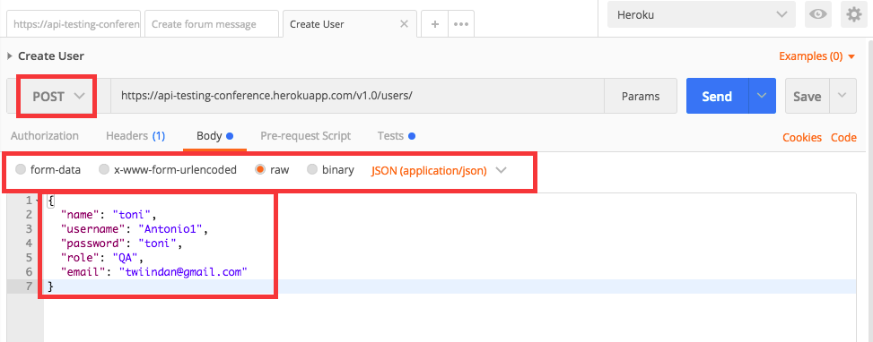
Create a POST request with body

Slide 45
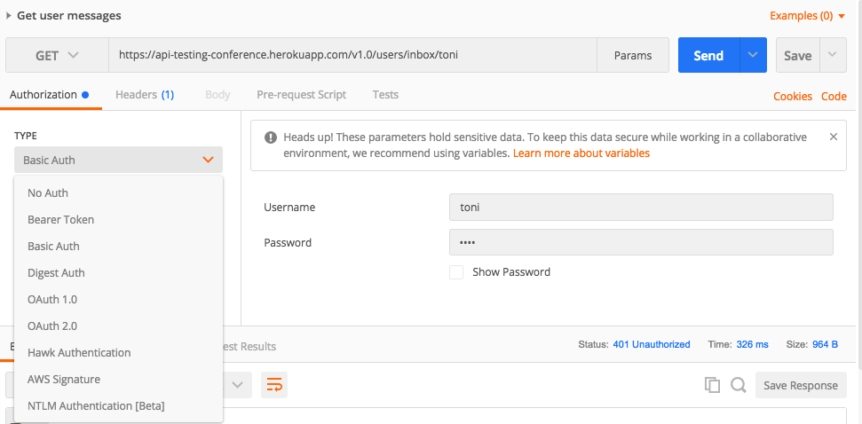
Authorization

Slide 46
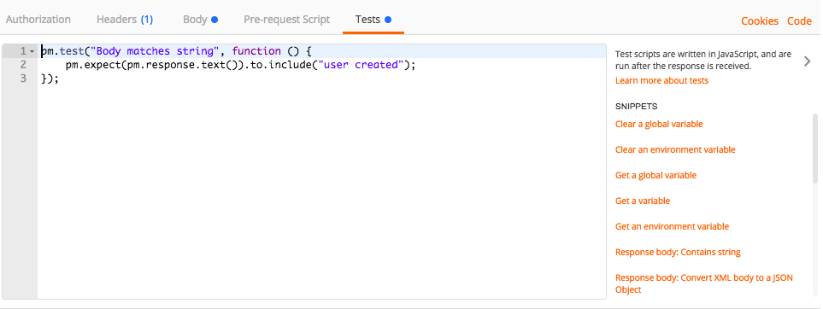
Assertions

Slide 47
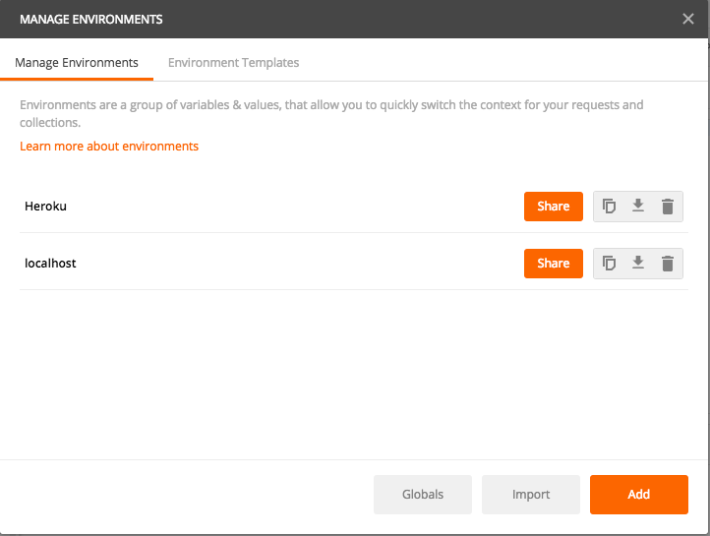
Environments

Slide 48
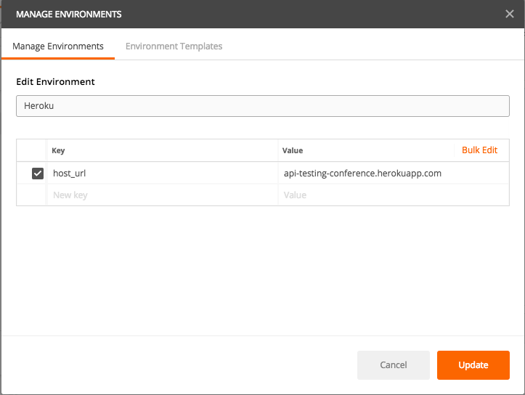
Environments

Slide 49
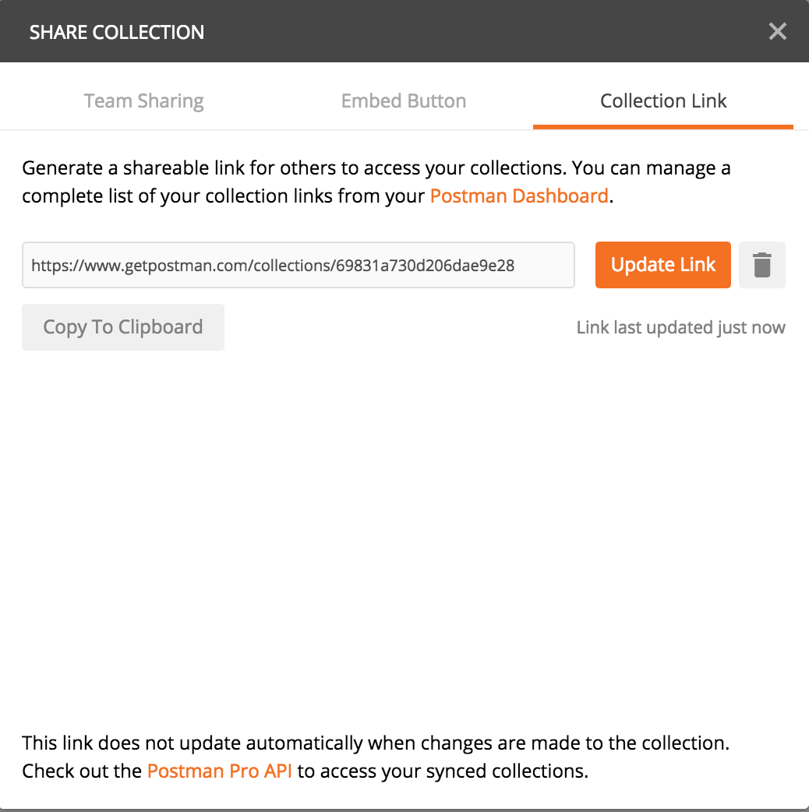
Export
Export to link

Slide 50
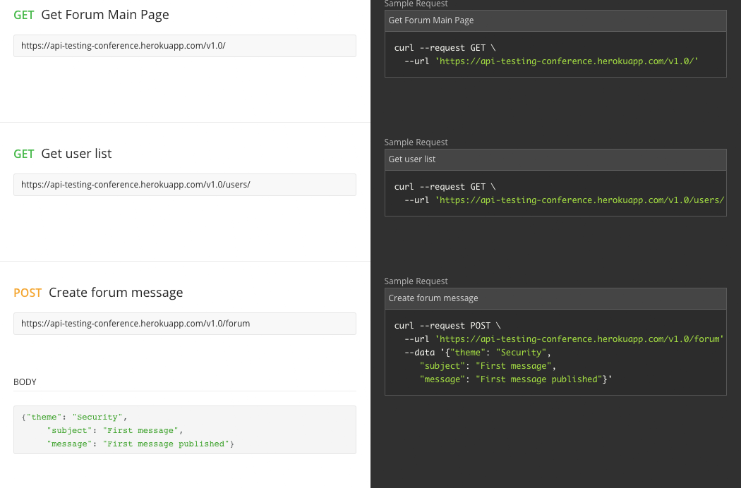
Documentation

Slide 51
Swagger / OpenAPI

Slide 52
Swagger
Tool for API REST management
Describe
Produce
Consume
Visualize
Available in almost all language programming

Slide 53
Swagger
REST API definition using JSON or YAML
Is possible generate:
Documentation
Mocks
Examples

Slide 54
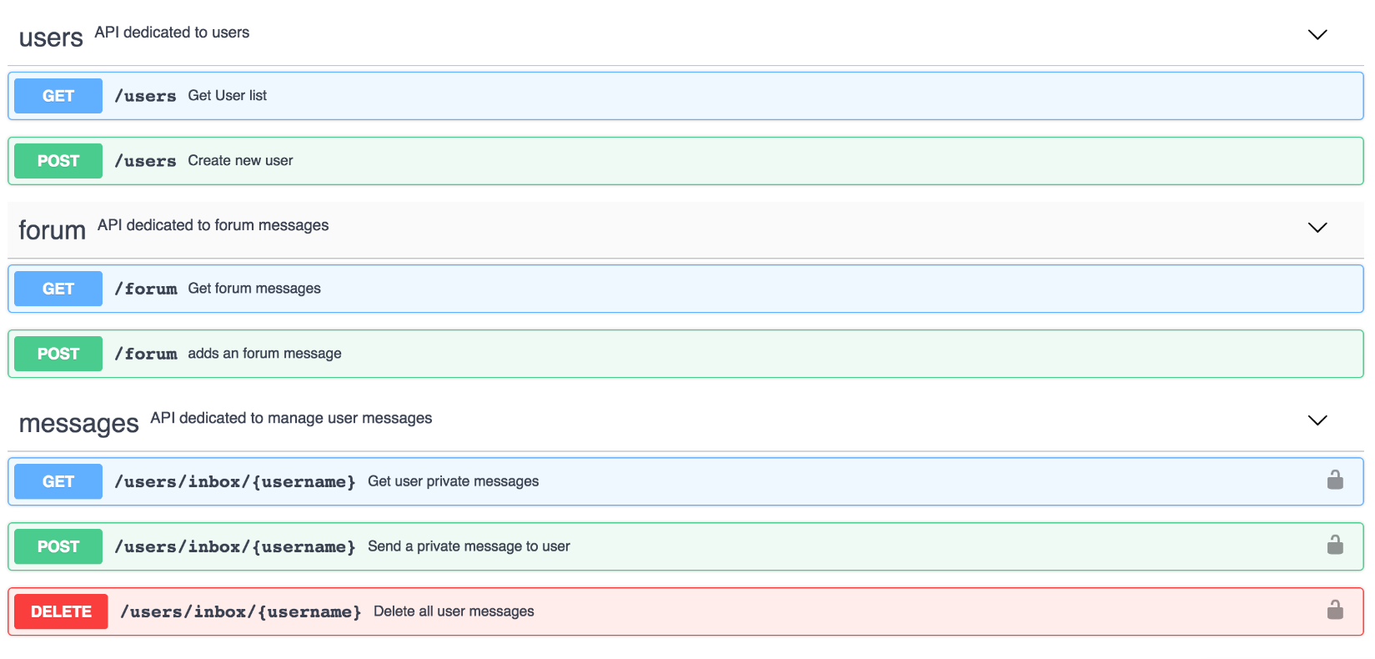
Demo
https://app.swaggerhub.com/api/twiindan/forum-conference/1.0.0

